Slide 1
Chapter 7
Transmission Media

Slide 2

Figure 7.1 Transmission medium and physical layer
7.<number>

Slide 3

Figure 7.2 Classes of transmission media
7.<number>

Slide 4
7-1 GUIDED MEDIA
Guided media, which are those that provide a conduit from one device to another, include twisted-pair cable, coaxial cable, and fiber-optic cable.
Topics discussed in this section:
Twisted-Pair Cable
Coaxial Cable
Fiber-Optic Cable
7.<number>

Slide 5
Transmission Characteristics of Guided Media
Frequency Range
Typical Attenuation
Typical Delay
Repeater Spacing
Twisted pair (with loading)
0 to 3.5 kHz
0.2 dB/km @ 1 kHz
50 µs/km
2 km
Twisted pairs (multi-pair cables)
0 to 1 MHz
0.7 dB/km @ 1 kHz
50 µs/km
2 km
Coaxial cable
0 to 500 MHz
7 dB/km @ 10 MHz
4 µs/km
1 to 9 km
Optical fiber
186 to 370 THz
0.2 to 0.5 dB/km
5 µs/km
40 km

Slide 6
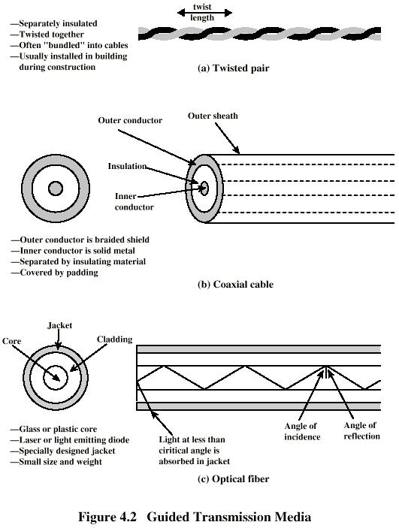
Twisted Pair ➔ Architecture
Two Insulated copper wires
Issues:
(1) Interference due to unwanted electrical coupling of two copper
(2) Interference due to unwanted electrical coupling between the neighboring twisted pairs

Slide 7

Figure 7.3 Twisted-pair cable
7.<number>

Slide 8
Twisted Pair ➔ Applications
Most commonly used medium
Telephone network
  Between house and local exchange (subscriber loop)
Within buildings
  To private branch exchange (PBX)
For local area networks (LAN)
  10Mbps or 100Mbps

Slide 9
Twisted Pair - Pros and Cons
Advantages
  Less expensive
  Easy to work with
Disadvantages
  Low data rate
  Short range

Slide 10
Twisted Pair (TP) ➔Characteristics
Analog transmission
  Amplifiers every 5km to 6km
Digital transmission
  Use either analog or digital signals
  repeater every 2km or 3km
TP is Limited
  Distance
  Bandwidth
  Data rate
Susceptible to interference and noise
  Easy coupling of electromagnetic fields

Slide 11
Unshielded and Shielded TP
Unshielded Twisted Pair (UTP)
  Ordinary telephone wire
  Less expensive
  Weak immunity against noise and interference
  Suffers from external EM interference
Shielded Twisted Pair (STP)
  An extra metallic sheath on each pair
  Relatively more expensive
  Provide better performance than UTP
    Increased Data rate
    Increased Bandwidth

Slide 12
UTP Categories
Cat 3
  up to 16MHz
  Voice grade found in most offices
  Twist length of 7.5 cm to 10 cm
Cat 4
  up to 20 MHz
Cat 5
  up to 100MHz
  Commonly pre-installed in new office buildings
  Twist length 0.6 cm to 0.85 cm
Cat 5E (Enhanced) –see tables
Cat 6
Cat 7

Slide 13

Figure 7.5 UTP connector
7.<number>

Slide 14
Coaxial Cable

Slide 15
Coaxial Cable ➔ Architecture

Slide 16
Coaxial Cable ➔Applications
Television (TV) signals distribution
  Ariel to TV
  Cable TV
Long distance telephone transmission
  Can carry 10,000 voice calls simultaneously
  Being replaced by fiber optic
Short distance computer systems links
  Local area networks (LAN)
  Metropolitan area network (MAN)

Slide 17
Coaxial Cable ➔Characteristics
Analog
  Amplifiers every few km
  Closer if higher frequency
  Up to 500MHz
Digital
  Repeater every 1km
  Closer for higher data rates
Problem
  Inter-modulation noise
  Thermal noise

Slide 18
Optical Fiber

Slide 19
Optical Fiber ➔ Architecture

Slide 20

Figure 7.7 Coaxial cable
7.<number>

Slide 21
Optical Fiber ➔ Benefits
Greater capacity
  Data rates of hundreds of Gbps
Smaller size & weight
  Made up of extremely thin fibers
Lower attenuation
  Electromagnetic isolation
Greater repeater spacing
  10s of km at least

Slide 22

Table 7.2 Categories of coaxial cables
7.<number>

Slide 23

Figure 7.8 BNC connectors
7.<number>

Slide 24
Optical Fiber

Slide 25
Optical Fiber ➔ Architecture

Slide 26
Optical Fiber ➔ Benefits
Greater capacity
  Data rates of hundreds of Gbps
Smaller size & weight
  Made up of extremely thin fibers
Lower attenuation
  Electromagnetic isolation
Greater repeater spacing
  10s of km at least

Slide 27
Optical Fiber - Transmission Characteristics
Operational range
  10¹⁴ to 10¹⁵ Hz
Light source
  Light Emitting Diode (LED)
    Cheaper
    Wider operating temperature range
    Last longer
  Injection Laser Diode (ILD)
    Operates on laser principle
    More efficient
    Greater data rate
Wavelength Division Multiplexing (WDM)

Slide 28

Figure 7.12 Propagation modes
7.<number>

Slide 29

Figure 7.15 Fiber-optic cable connectors
7.<number>

Slide 30
7-2 UNGUIDED MEDIA: WIRELESS
Unguided media transport electromagnetic waves without using a physical conductor. This type of communication is often referred to as wireless communication.
Topics discussed in this section:
Radio Waves
Microwaves
Infrared
7.<number>

Slide 31

Figure 7.17 Electromagnetic spectrum for wireless communication
7.<number>

Slide 32

Figure 7.18 Propagation methods
7.<number>

Slide 33

Table 7.4 Bands
7.<number>

Slide 34

Figure 7.19 Wireless transmission waves
7.<number>

Slide 35

Note
Radio waves are used for multicast communications, such as radio and television, and paging systems. They can penetrate through walls.
Highly regulated. Use omni directional antennas
7.<number>

Slide 36

Figure 7.20 Omnidirectional antenna
7.<number>

Slide 37
Note
Microwaves are used for unicast communication such as cellular telephones, satellite networks,
and wireless LANs.
Higher frequency ranges cannot penetrate walls.
Use directional antennas - point to point line of sight communications.
7.<number>

Slide 38

Figure 7.21 Unidirectional antennas
7.<number>

Slide 39
Note
Infrared signals can be used for short-range communication in a closed area using line-of-sight propagation.
7.<number>

Slide 40
Wireless Channels
Are subject to a lot more errors than guided media channels.
Interference is one cause for errors, can be circumvented with high SNR.
The higher the SNR the less capacity is available for transmission due to the broadcast nature of the channel.
Channel also subject to fading and no coverage holes.
7.<number>

Slide 41
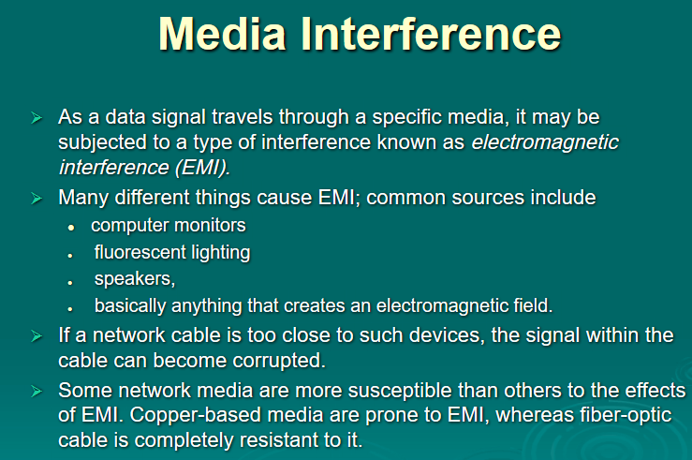
7.<number>

